Slide 1


Reduced Local BOLD Correlation in Pre-Frontal Cortex during Deep Sleep
# 2868
Xiao Liu¹, Silvina G. Horovitz^{1,2}, Allen R. Braun³, Walter S. Carr⁴, Dante Picchionie⁵, Masaki Fukunaga¹, and Jeff H. Duyn¹
¹AMRI, LFMI, NINDS, NIH ²HMCS, NINDS, NIH ³VSLB, NIDCD, NIH, ⁴Naval Medical Research Center, ⁵Department of Behavioral Biology, Walter Reed Army Institute of Research
Melbourne, Australia
May 5th-11th, 2012

Slide 2
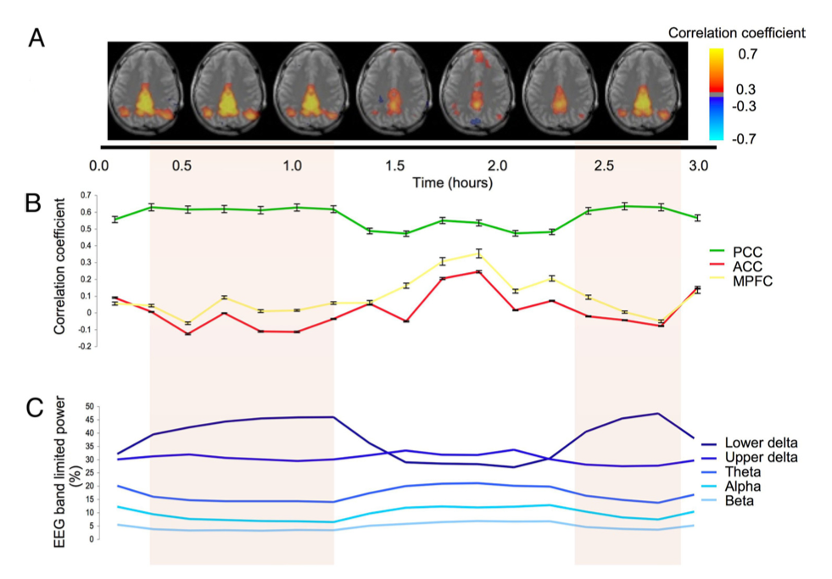
Decoupled Prefrontal DMN Component During Deep Sleep
Prefrontal part of default mode network (DMN) reduces its BOLD correlations with other DMN components during deep sleep.
Background Methods Results Discussions
Further question: other than the long-range BOLD correlation, does the local BOLD correlations also change during deep sleep?
Horovitz, S.G., PNAS, 2009

Slide 3
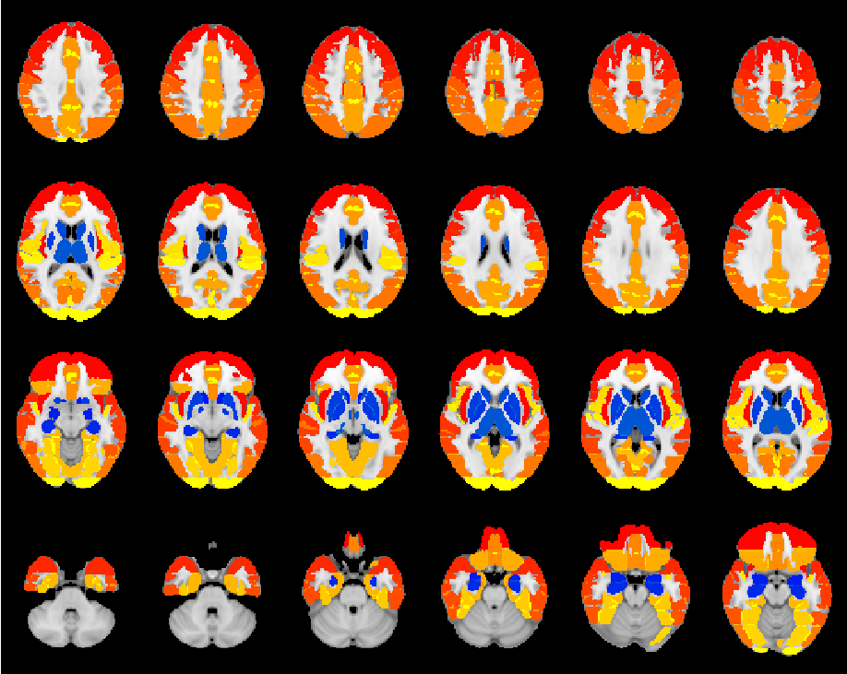
Reanalyzing Previous Dataset
Reprocessing Notes
Reprocess dataset published previously (Horovitz, S.G., PNAS, 2009)
Only include 7 subjects with separate wake data acquisition
Divide data into 300-sec segments
Carefully avoid periods with serious head motion
Background Methods Results Discussions
Separate pure Stage 2 from those mixed with Stage 3~4 sleep
Regress out global signal and physiological noise
Align to Harvard-Oxford-Atlas
Cortical
Subcortical
ROI #
1
48
55

Slide 4
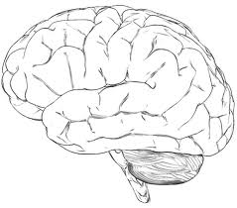
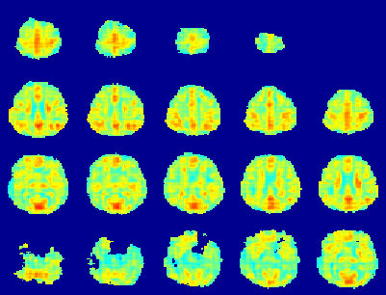
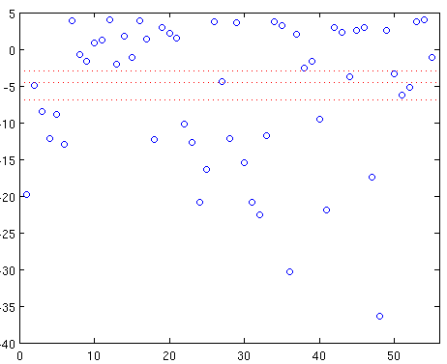
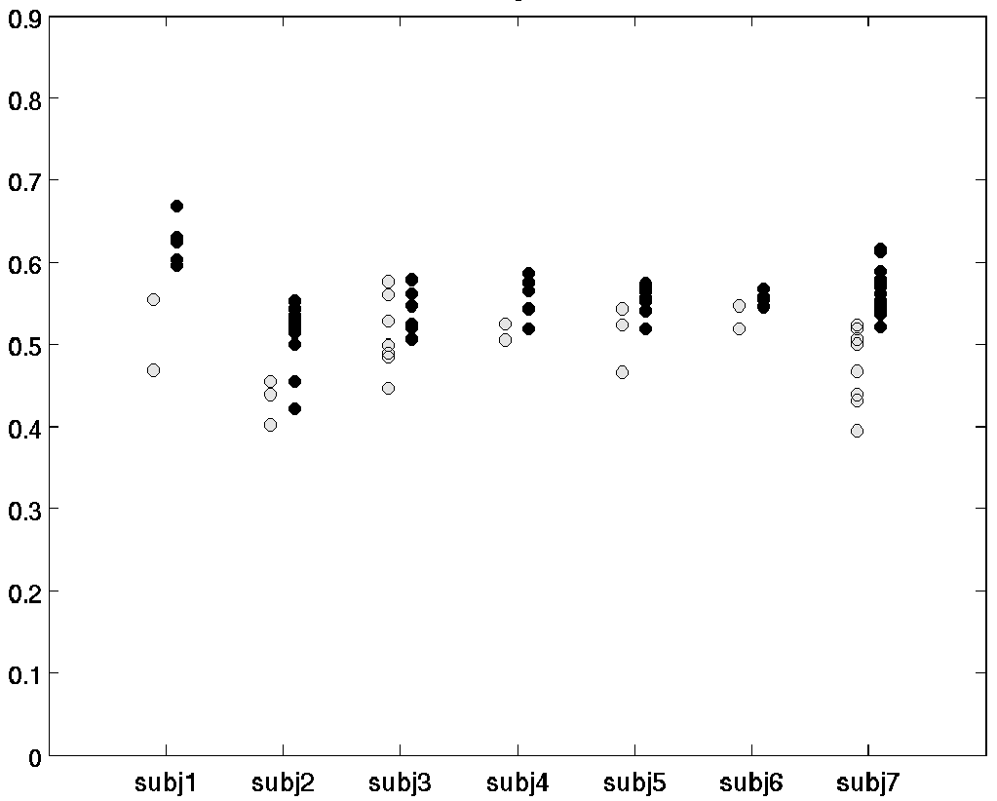
Local BOLD Correlation: Regional Homogeneity (ReHo*)
Averaged pairwise BOLD correlations within a 3x3x3-voxel cube
ReHo Map
Using atlas ROIs
Background Methods Results Discussions
Wake
Deep Sleep
Log (p-value)
Statistical Inference
for each ROI
An Example of ROIs:
Posterior Cingulate Cortex
PCC Example
ROI #
* Zhang, Y., NeuroImage, 2004

Slide 5
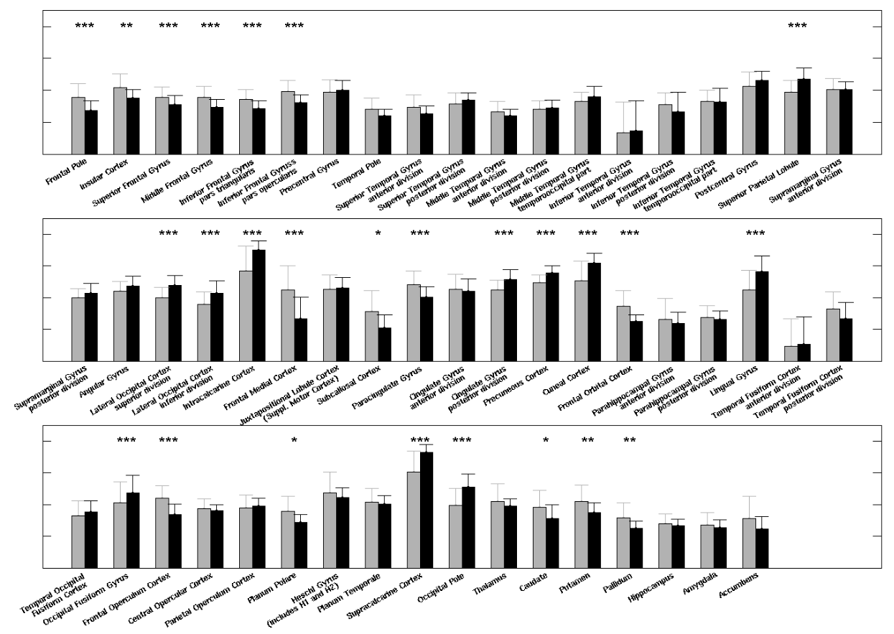
ROI Analysis Result
ReHo
0.8
0.6
Background Methods Results Discussions
0.4
0.2
Wake
Deep Sleep
p-value
< 0.05 *
< 0.01 **
<0.001 ***
Decreased Local correlation
Increased Local correlation

Slide 6
ROI Analysis Result
ROIs showing significant ReHo modulation during deep sleep
Background Methods Results Discussions
p-value (Bonf. Corrected)
Anterior and posterior brain show opposite modulation !
10⁻¹⁰
10⁻³
10⁻³
10⁻¹⁰
Wake > Deep Sleep
Wake < Deep Sleep

Slide 7
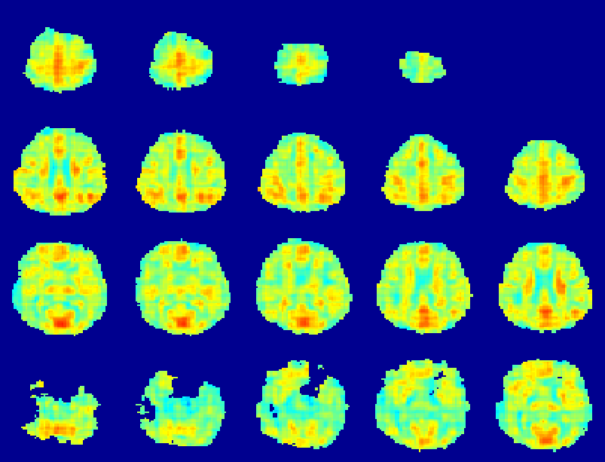
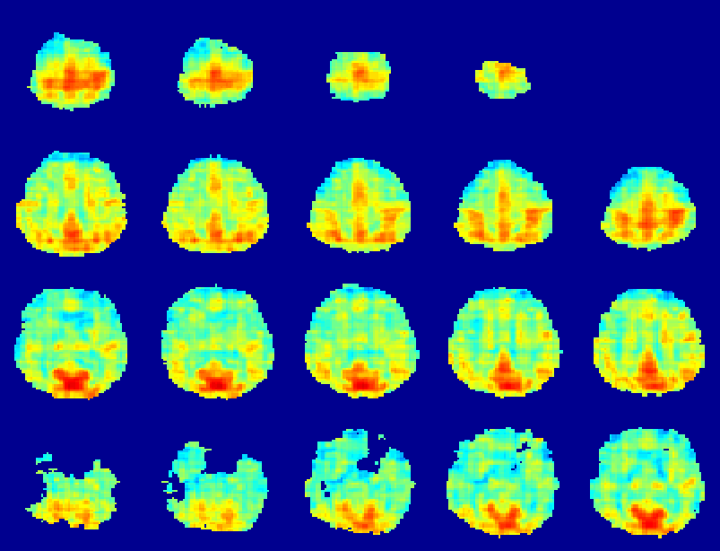
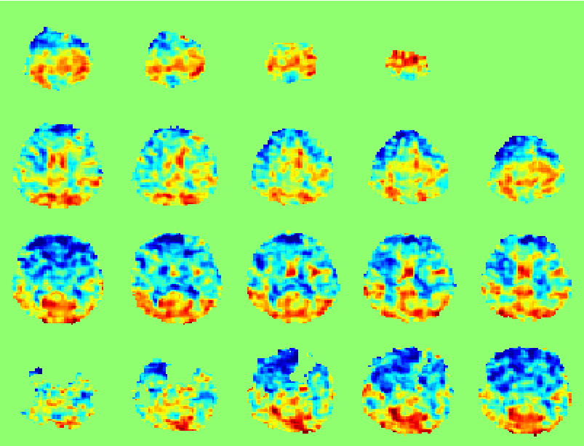
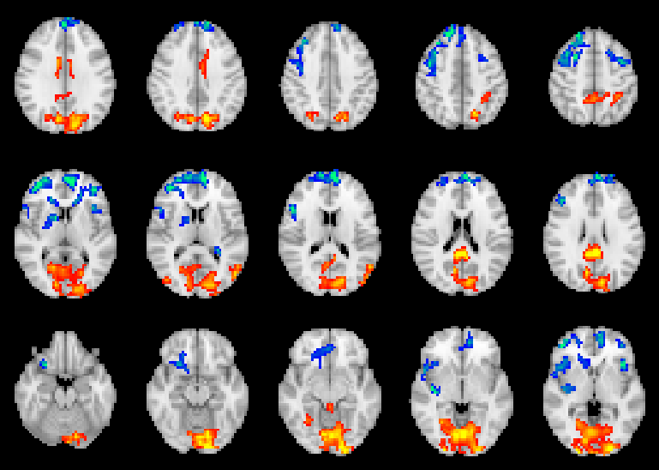
Group ReHo Map
Wake (n=27)
Deep Sleep (n=58)
0
1
0
1
Background Methods Results Discussions
Deep Sleep − Wake
Deep Sleep − Wake
-0.2
0.2
p (Bonf. Corrected)
10⁻¹⁰
0.05
0.05
10⁻¹⁰
< Wake
> Wake

Slide 8
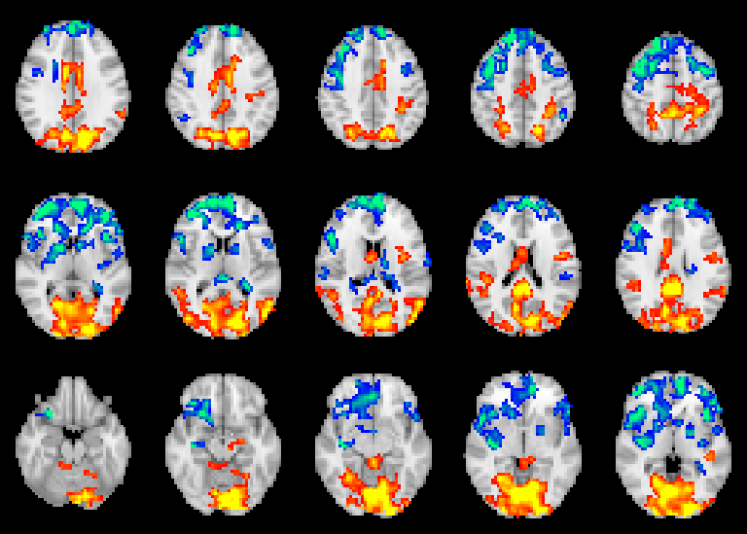
Group ReHo Map
Wake (n=27)
Deep Sleep (n=58)
Amplitude of fMRI BOLD fluctuation
Local fMRI BOLD correlation change
0
1
0
1
Background Methods Results Discussions
?
Deep Sleep − Wake
Deep Sleep − Wake
-0.2
0.2
p (Uncorrected)
10⁻¹⁰
10⁻³
10⁻³
10⁻¹⁰
< Wake
> Wake

Slide 9
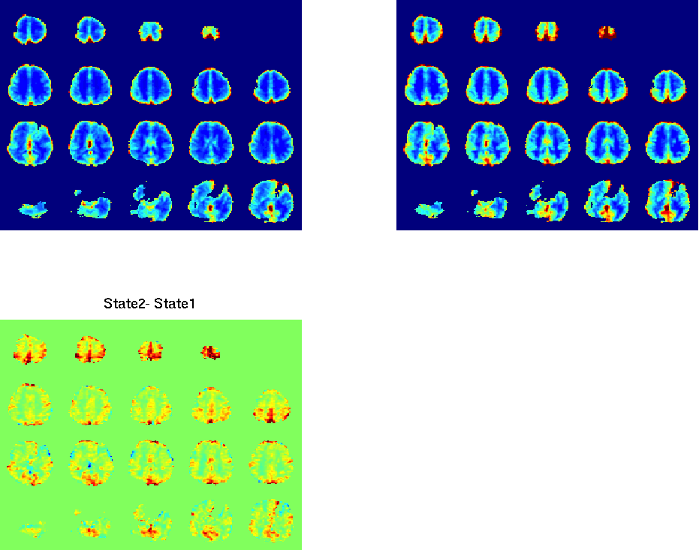
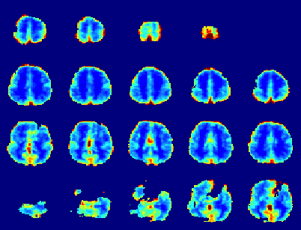
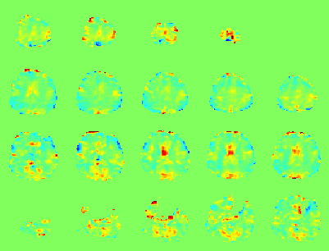
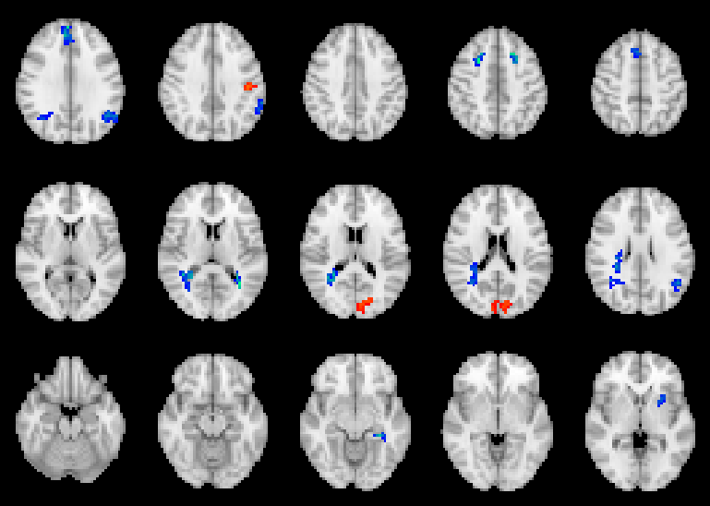
Group Map of BOLD Fluctuation Amplitude (Standard Deviation)
Wake (n=27)
Deep Sleep (n=58)
0%
2%
0%
2%
Background Methods Results Discussions
Deep Sleep − Wake
Deep Sleep − Wake
-1%
1%
p (Bonf. Corrected)
10⁻¹⁰
0.05
0.05
10⁻¹⁰
< Wake
> Wake

Slide 10
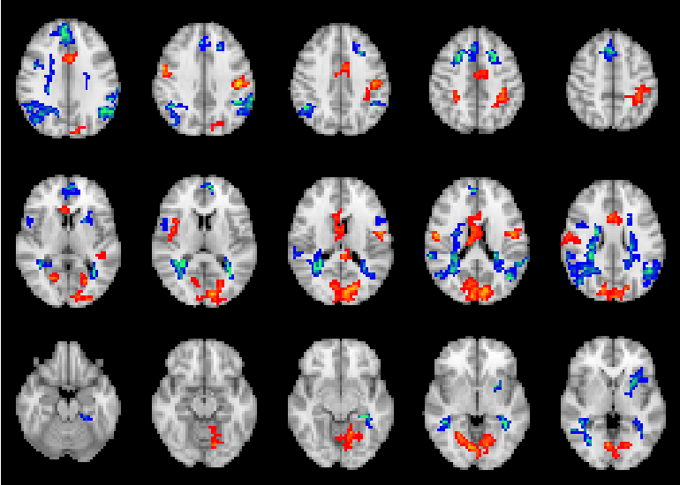
Group Map of BOLD Fluctuation Amplitude (Standard Deviation)
Wake (n=27)
Deep Sleep (n=58)
No correspondent modulation in BOLD fluctuation amplitude
0%
2%
0%
2%
Background Methods Results Discussions
Deep Sleep − Wake
Deep Sleep − Wake
-1%
1%
p (Uncorrected)
10⁻¹⁰
10⁻³
10⁻³
10⁻¹⁰
< Wake
> Wake

Slide 11
Discussion
During deep sleep, local fMRI signal correlations alter in a distinct, spatially consistent manner, with prefrontal regions showing a decrease and posterior regions showing an increase.
Background Methods Results Discussions
This observation is consistent with the notion that higher level cognitive function, commonly associated with frontal cortex, is reduced during sleep.
Analysis of local correlations patterns may provide information about the brain’s cognitive state that is supplemental to information derived from long-range correlation analysis

Slide 12
Acknowledgements
Dr. Thomas J. Balkin,
NINDS, WRAIR, and NIDCD
References
Background Methods Results Discussions
[1] Biswal, B. et al. MRM 1995
[2] Horovitz, SG. et al. PNAS 2009
[3] Spoormaker, VI. et al. J. Neurosci. 2010.
[4] Boly, M. et al. Ann N Y Acad Sci. 2008.
[5] Vincent, JL. et al. Nature. 2007.
[6] Desikan, RS. et al. NeuroImage. 2006 .
Thank you!

